Slide 1
Introduction to Data Analytics
Day 5

Slide 2
Bivariate Analysis
Bivariate analysis is a statistical method used to examine the relationship between two variables
An association exists between two variables if a particular value of one variable is more likely to occur with certain values of the other variable.
• For higher levels of energy use, does the CO2 level in the atmosphere tend to be higher? If so, then there is an association between energy use and CO2 level.
• Positive Association: As x goes up, y tends to go up.
• Negative Association: As x goes up, y tends to go down

Slide 3
Bivariate analysis
How can we explore the relationship between two quantitative variables?
Graphically, we can construct a scatterplot.
Numerically, we can calculate a correlation coefficient and a regression equation

Slide 4
Correlation
Correlation is a statistical measure that describes the relationship between two variables. It indicates the extent to which changes in one variable are associated with changes in another variable. In other words, it helps us understand how closely related two variables are.
The strength of the relationship is the closeness of the points to a straight line. The magnitude is the measure of the strength. When 𝐫 = −𝟏 𝐨𝐫 + 𝟏 then it indicates a perfect relationship, but when, 𝐫 = 𝟎 it indicates no linear relationship. The words “ weak”, “moderate”, and “strong” are used to describe the strength of the relationship between the two variable

Slide 5
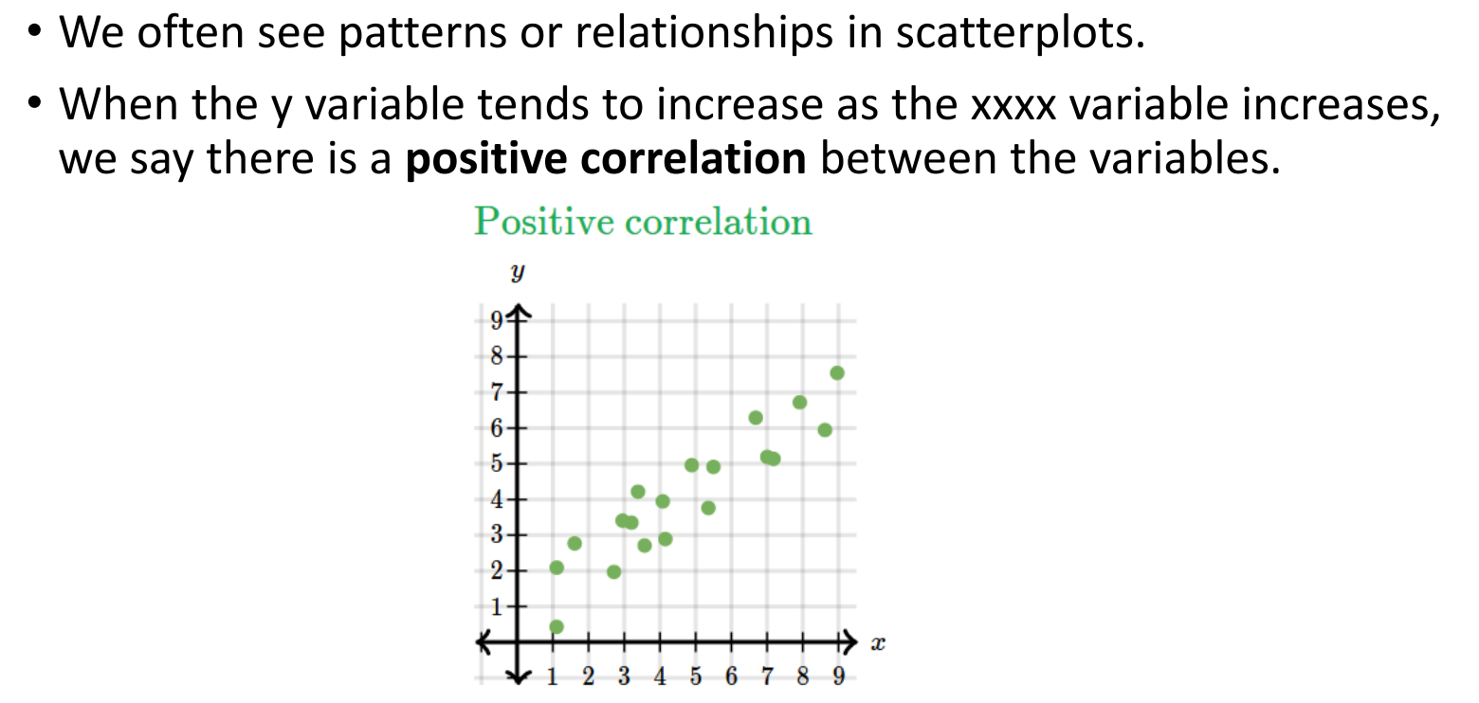
What is correlation?

Slide 6
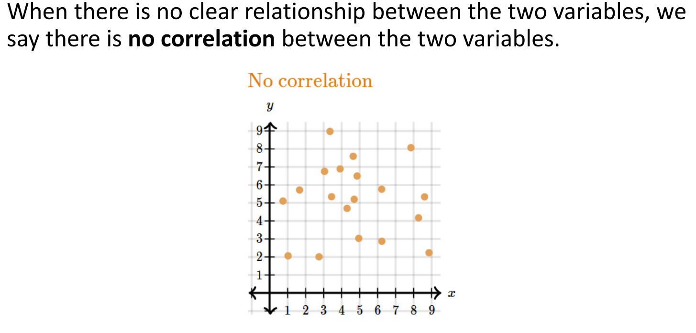
No correlation

Slide 7
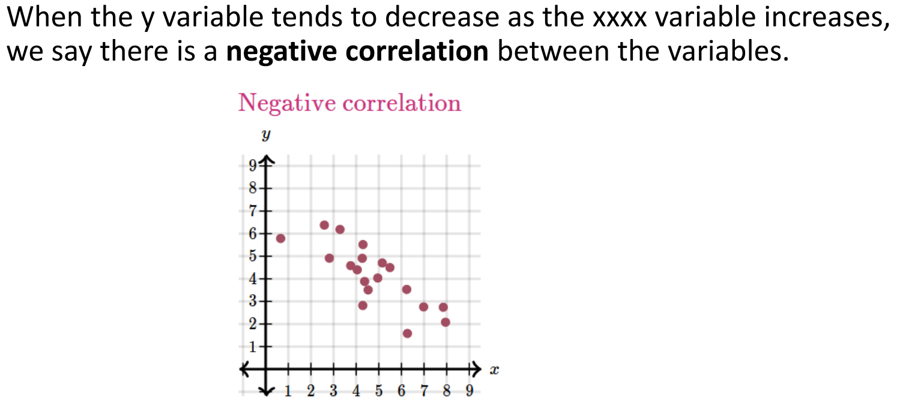
Negative correlation

Slide 8
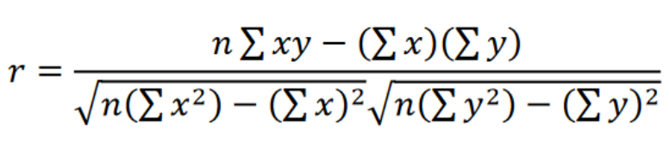
Pearson correlation coefficient
The direction is whether one variable generally increases or generally decreases when the other variable increases. The sign is the measure of the direction
• The Pearson correlation coefficient is calculated through the formula

Slide 9
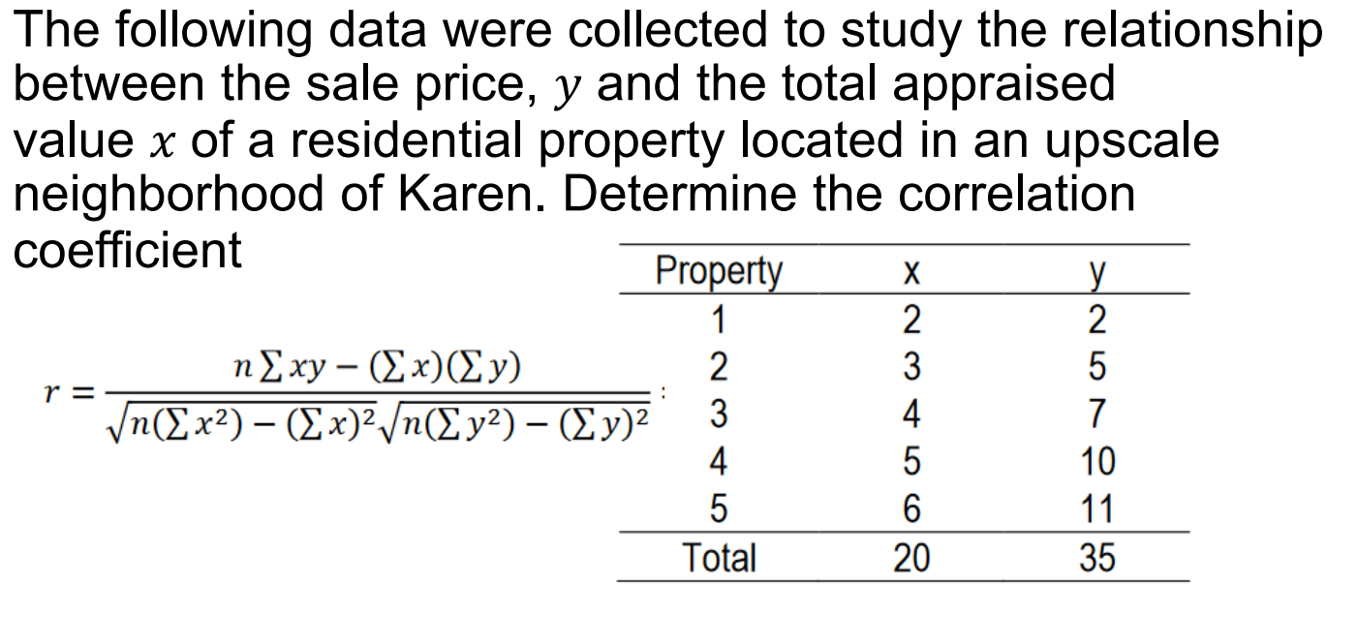

Slide 10
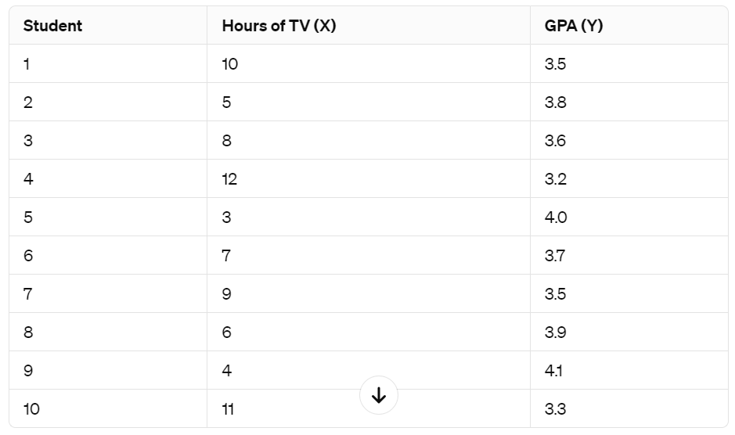
Ex1
Suppose we have data on the number of hours spent watching TV per week and the GPA (Grade Point Average) of students in a class. Calculate the correlation coefficient (r)

Slide 11
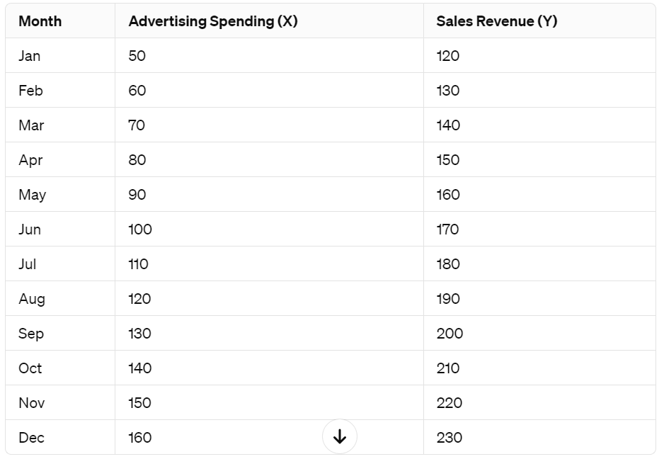
Ex2
Let's consider data on the monthly advertising spending (in thousands of dollars) and monthly sales revenue (in thousands of dollars) of a retail store over the past year. Determine R

